Slide 1
Surds (I know, finally!!!)
Maths 10A

Slide 2
Complete Learning Log for last Topic – Index Laws/Algebraic Fractions

Slide 3

Learning Intentions
To learn what a surd is and, equally important, what isn’t a surd
To further expand and solidify our mathematical vocabulary
To apply the four basic operations to surds
To be able to properly express surds mathematically
WICOR

Slide 4

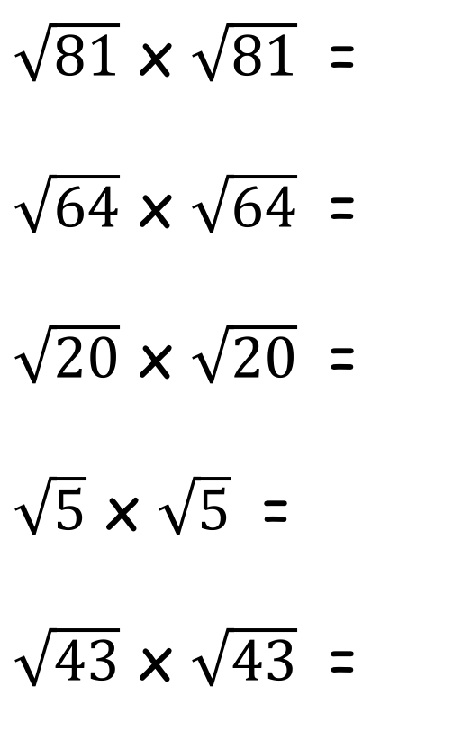
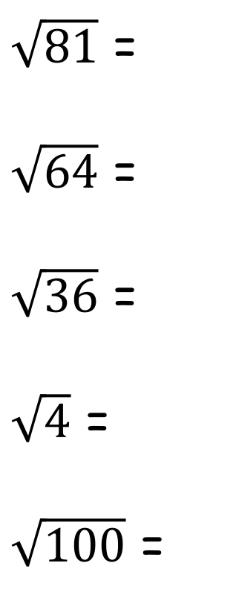
Starter
LHS of INB
4
25
81
16
121
2² =
5² =
9² =
4² =
11² =
$\sqrt{81}$ =
$\sqrt{64}$ =
$\sqrt{36}$ =
$\sqrt{4}$ =
$\sqrt{100}$ =
9
8
6
2
10
$\sqrt{81}$ x $\sqrt{81}$ =
$\sqrt{64}$ x $\sqrt{64}$ =
$\sqrt{20}$ x $\sqrt{20}$ =
$\sqrt{5}$ x $\sqrt{5}$ =
$\sqrt{43}$ x $\sqrt{43}$ =
81
64
20
5
43

Slide 5
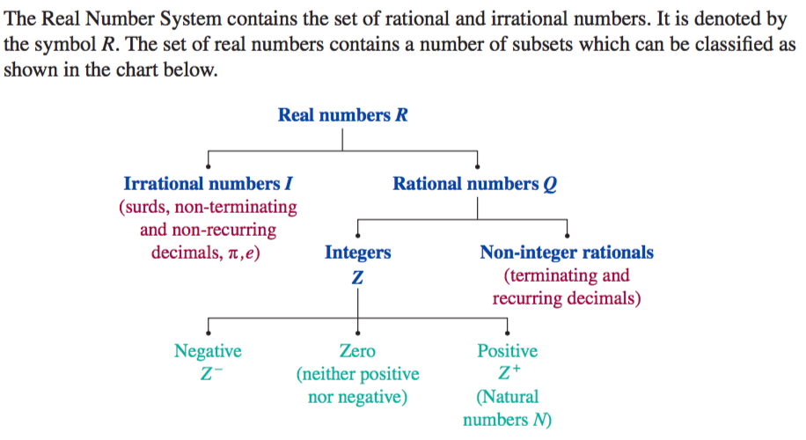
24
7
30
Surds
Date
EQ – What are surds and what are some key properties of them?
First, a
review:

Slide 6
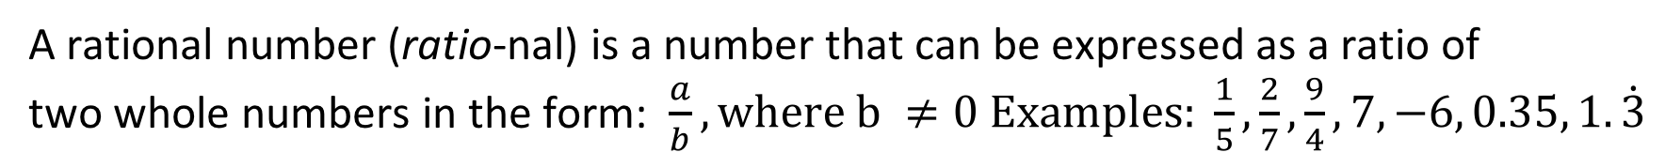
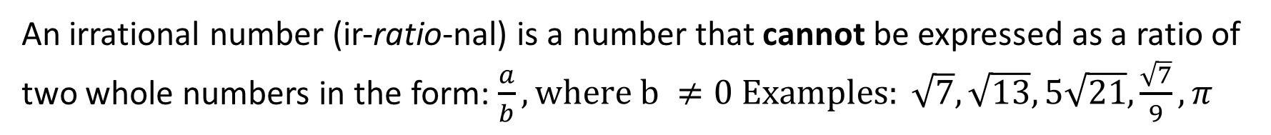
24
7
30
Surds
Date
EQ – What are surds and what are some key properties of them?
Rational
Numbers
A rational number (ratio-nal) is a number that can be expressed as a ratio of
two whole numbers in the form: $\frac{a}{b}, where b ≠0 Examples: \frac{1}{5}, \frac{2}{7}, \frac{9}{4}, 7, −6, 0.35, 1.\dot{3}$
Irrational
Numbers
An irrational number (ir-ratio-nal) is a number that cannot be expressed as a ratio of two whole numbers in the form: $\frac{a}{b}, where b ≠0 Examples: \sqrt{7}, \sqrt{13}, 5\sqrt{21}, \frac{\sqrt{7}}{9}, π$
So, what
are surds?
A surd is an irrational number that is represented by a root sign or a radical sign. In other words, a surd is a square root which cannot be reduced to a whole number.
Examples:
√2 is a surd.
√5 is a surd.
√81 looks like a surd, but isn't really...

Slide 7
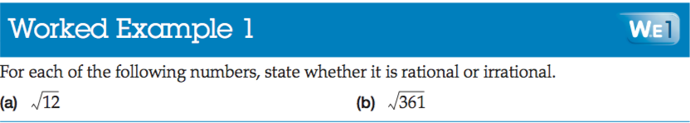
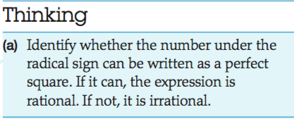
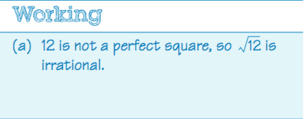
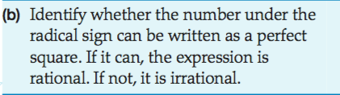
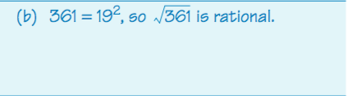
24
7
30
Surds
Date
EQ – What are surds and what are some key properties of them?

Slide 8


Slide 9
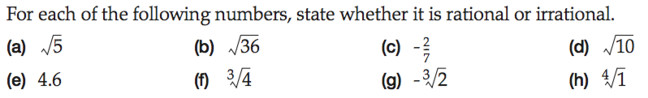
24
7
30
Surds
Date
EQ – What are surds and what are some key properties of them?

Slide 10

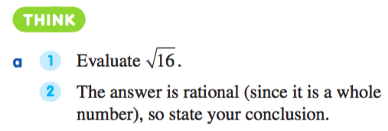
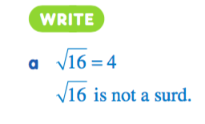
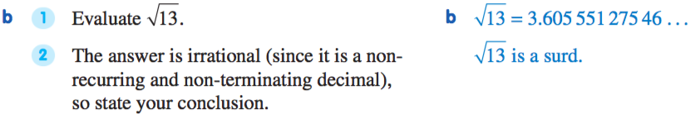
24
7
30
Surds
Date
EQ – What are surds and what are some key properties of them?

Slide 11
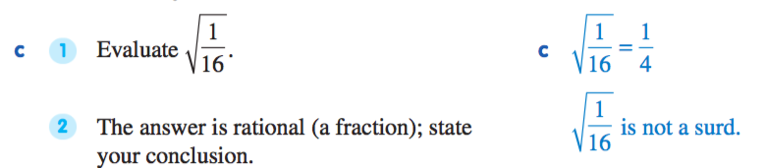
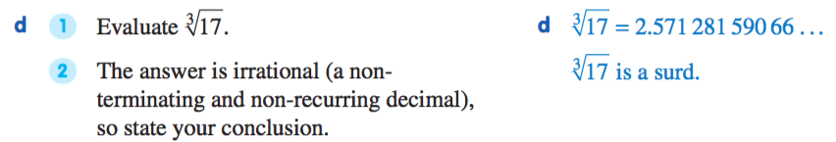
24
7
30
Surds
Date
EQ – What are surds and what are some key properties of them?
Do e) and e)
on your own!!!!

Slide 12
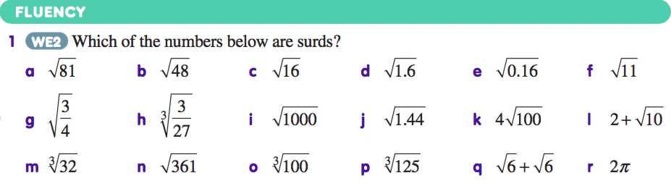

Slide 13
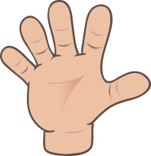
Do you understand? Fists of Five
Notes:
Check for Understanding

Slide 14
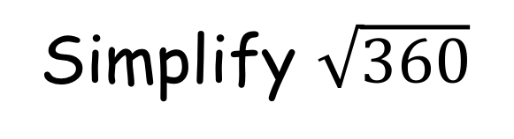
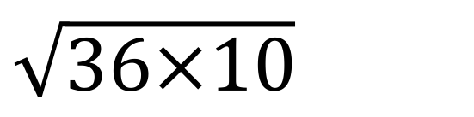
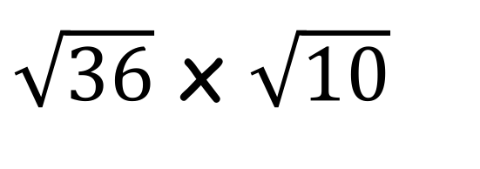
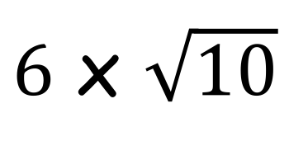

24
7
30
Surds
Date
EQ – What are surds and what are some key properties of them?
How to simplify surds
How do we simplify surds?
Simplify $\sqrt{360}$
Remember this
general rule. We’ll
see it again soon!
$\sqrt{36×10}$
1. Look for a factor that is a square number.
$\sqrt{36}$ x $\sqrt{10}$
$6$ x $\sqrt{10}$
2. Use the rule to split your square roots.
$$6\sqrt{10}$$
3. Simplify your answer.

Slide 15
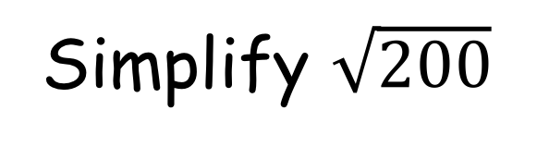
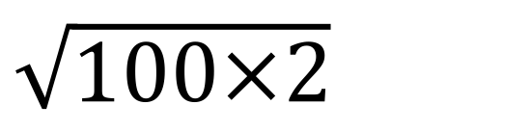
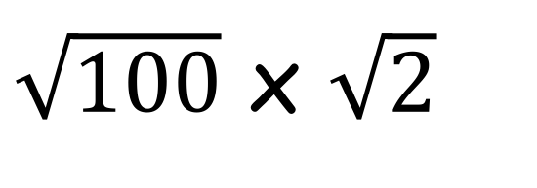
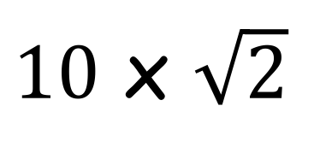

24
7
30
Surds
Date
EQ – What are surds and what are some key properties of them?
How do we simplify surds?
Simplify $\sqrt{200}$
$\sqrt{100×2}$
1. Look for a factor that is a square number.
$\sqrt{100}$ x $\sqrt{2}$
$10$ x $\sqrt{2}$
2. Use the rule to split your square roots.
$$10\sqrt{2}$$
3. Simplify your answer.

Slide 16




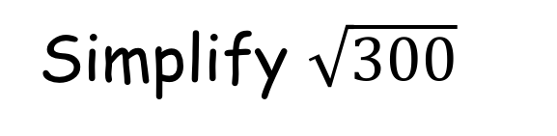




24
7
30
Surds
Date
EQ – What are surds and what are some key properties of them?
Simplify $\sqrt{300}$
How do we simplify surds?
$\sqrt{25×12}$
$\sqrt{25}$ x $\sqrt{12}$
$5$ x $\sqrt{12}$
1. Look for a factor that is a square number.
$5\sqrt{12}$ ???
$5$ x $\sqrt{4×3}$
2. Use the rule to split your square roots.
$5$ x $\sqrt{4}$ x $\sqrt{3}$
$5$ x $2$ x $\sqrt{3}$
3. Simplify your answer.
$$10\sqrt{3}$$

Slide 17
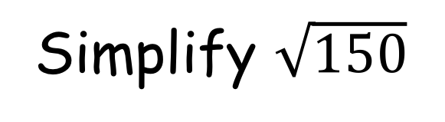
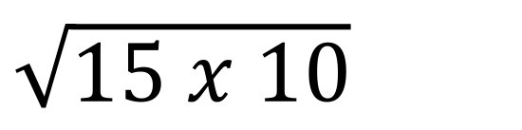
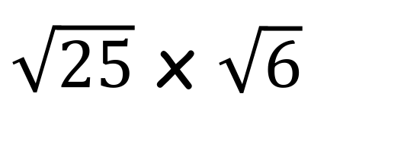
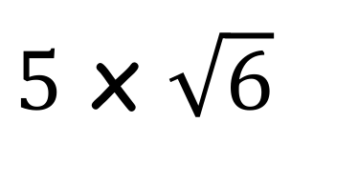
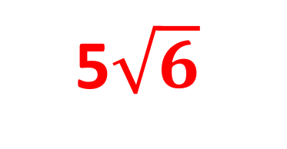
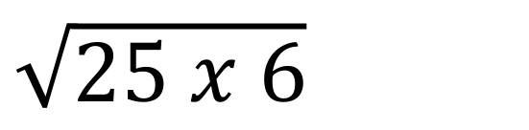
24
7
30
Surds
Date
EQ – What are surds and what are some key properties of them?
Simplify $\sqrt{150}$
How do we simplify surds?
We’ve hit a road
block. These are
both factors of
150, but are not
square numbers
$\sqrt{15 x 10}$
$\sqrt{25 x 6}$
1. Look for a factor that is a square number.
$\sqrt{25}$ x $\sqrt{6}$
2. Use the rule to split your square roots.
$5$ x $\sqrt{6}$
5$\sqrt{6}$
3. Simplify your answer.

Slide 18



Individual work
Express these in their simplest form. (simplify them).
$$\sqrt{50}$$
$$\sqrt{54}$$
$$\sqrt{44}$$
$$\sqrt{72}$$
$$\sqrt{180}$$
$$\sqrt{128}$$
$$\sqrt{350}$$
$$\sqrt{108}$$
$$\sqrt{252}$$

Slide 19



Individual work
Express these in their simplest form. (simplify them). ANSWERS
$$5\sqrt{2}$$
$$3\sqrt{6}$$
$$2\sqrt{11}$$
$$6\sqrt{2}$$
$$6\sqrt{5}$$
$$8\sqrt{2}$$
$$5\sqrt{14}$$
$$6\sqrt{3}$$
$$6\sqrt{7}$$

Slide 20
Complete Surds Exit Ticket 1

